Slide 1
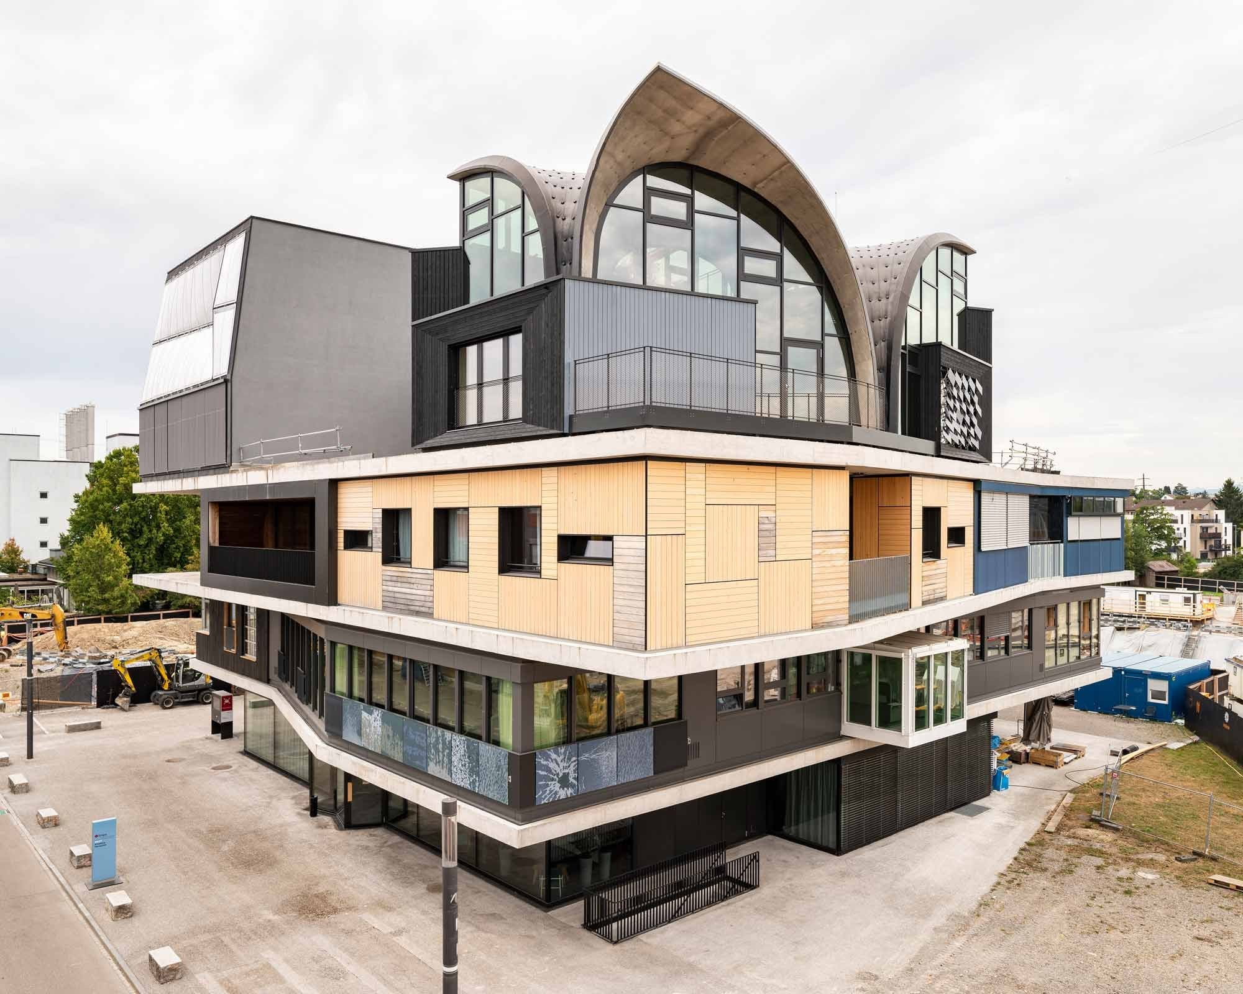
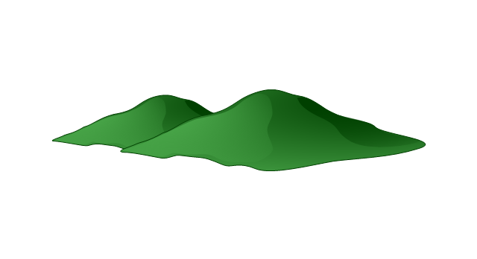

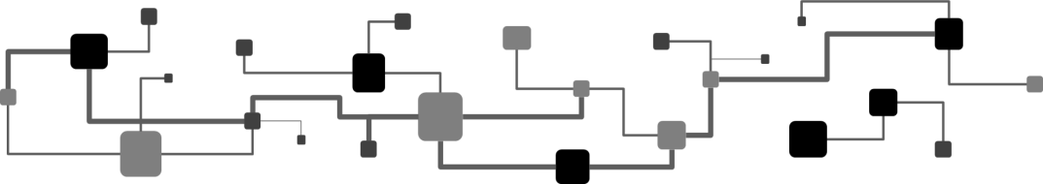
Physics-inspired Neural Networks for building modeling and control
Loris Di Natale ^{1,2} Bratislav Svetozarevic ¹ Philipp Heer ¹ Colin N. Jones ²
¹Urban Energy Systems Lab, Empa, Switzerland
²Automatic Control Lab, EPFL, Switzerland
American Control Conference 2023, San Diego

Slide 2



Neural Networks and physical systems
Neural Networks (NNs) achieve amazing performance…
… but can also fail spectacularly
They only do exactly what they are taught
What about controlling (real-world) physical systems with NNs?
Data quantity/quality issues
Time to converge
Exploration phase
Guarantees?
******
The Guardian
NEST, Empa, Dübendorf
Switzerland, © Zooey Braun
Go back to simulation
Notes:
Just some of many many examples
Building as running examples in this talk
Data for pretraining

Slide 3

Neural Networks and physical systems
Trained sequentially from data
Can choose to use a NN to model the system as well
Model
Controller
Data
train
train
deploy
It works! Can save 25-30% of energy on UMAR compared to industrial baselines,^{[1]} but…
Notes:
On this specific building

Slide 4
Neural Networks are physics-agnostic
Model
They attain great accuracy
They can violate physical laws ^{[2,3]}
Heating and cooling have almost no (or even reversed) impact
Can we help NNs?
We often have some prior knowledge of the system
Notes:
In the case of physical systems
We (often) know a lot about the system to control
Simplified model
Simplified controller
…
→ Prior (physical) knowledge of the system

Slide 5
PiNNs for supervised learning
Model
Given a dataset
backpropagation
Notes:
Learning from scratch is the usual way

Slide 6
PiNNs for supervised learning
Model
Given a dataset
Main idea: Modified loss function to steer the NN towards expected solutions
Boundary conditions
Physical laws (energy/mass/momentum conservation, …)
backpropagation
Notes:
Learning from scratch is the usual way
Here say physics but can be any type of knowledge really

Slide 7
Do PiNNs work?
Model
Want to ensure physical consistency: ^{[3]}
Idea: heating must heat the building
Does not solve our issues!
Notes:
In the case of physical systems
Again, there are a lot of ways to go about it, we chose this formulation

Slide 8
PiNNs for supervised learning
Model
Modified physical losses are a good start to help NNs
Hamiltonian NNs,^{[4]} Lagrangian NNs,^{[5]} …
Pros
Ease of implementation
Can accelerate learning
Can improve the solution
Cons
Hyperparameter tuning
No guarantees
Whenever possible, you can also try to use tailored architectures
Notes:
In the case of physical systems

Slide 9
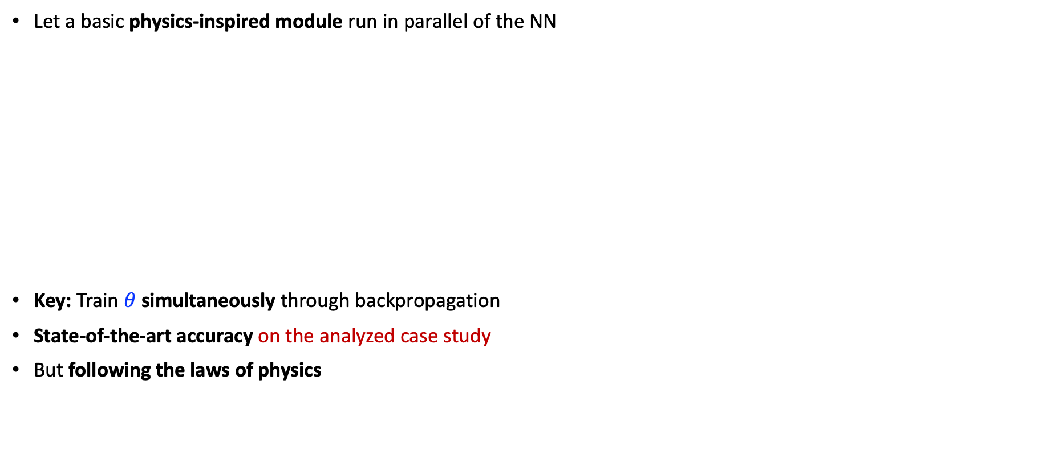
Physically Consistent NNs (PCNNs) ^{[6]}
Model
Let a basic physics-inspired module run in parallel of the NN
Key: Train $θ$ simultaneously through backpropagation
State-of-the-art accuracy on the analyzed case study
But following the laws of physics

Slide 10
Neural Networks and physical systems
Model
Controller
Data
train
train
deploy
If you have a good model, you can use MPC, unless it is impractical

Slide 11
PiNNs for reinforcement learning
Controller
Learning through interaction with the environment
Environment
Notes:
Might be interesting if you know the output is some combination of three variables e.g. – encourages the NN to find these variables and then predict the output from them

Slide 12
PiNNs for reinforcement learning
Controller
Learning through interaction with the environment
Reward shaping: modify the feedback to the network (e.g., constraints violations, …)
Environment
Notes:
Sort of the equivalent to PiNNs in supervised learning – could also add an output or a bottleneck to the network and penalize it in the reward if there is something else we want

Slide 13
PiNNs for reinforcement learning
Controller
Learning through interaction with the environment
Reward shaping: modify the feedback to the network (e.g., constraints violations, …)
Residual learning: additive, multiplicative, time varying, …
Environment
Notes:
Might be interesting if you know the output is some combination of three variables e.g. – encourages the NN to find these variables and then predict the output from them

Slide 14
PiNNs for reinforcement learning
Controller
Learning through interaction with the environment
Reward shaping: modify the feedback to the network (e.g., constraints violations, …)
Residual learning: additive, multiplicative, time varying, …
Shielding: Define a filter to correct the agent when some specifications are not met
Shield
Environment
Notes:
Might be interesting if you know the output is some combination of three variables e.g. – encourages the NN to find these variables and then predict the output from them

Slide 15
PiNNs for reinforcement learning
Controller
Learning through interaction with the environment
Reward shaping: modify the feedback to the network (e.g., constraints violations, …)
Residual learning: additive, multiplicative, time varying, …
Shielding: Define a filter to correct the agent when some specifications are not met
Project on the desired set
Shield
Environment
Notes:
Might be interesting if you know the output is some combination of three variables e.g. – encourages the NN to find these variables and then predict the output from them

Slide 16
PiNNs for reinforcement learning
Controller
Learning through interaction with the environment
Reward shaping: modify the feedback to the network (e.g., constraints violations, …)
Residual learning: additive, multiplicative, time varying, …
Shielding: Define a filter to correct the agent when some specifications are not met
Project on the desired set
Use a known fallback controller
Shield
Environment
Notes:
Might be interesting if you know the output is some combination of three variables e.g. – encourages the NN to find these variables and then predict the output from them

Slide 17
PiNNs for reinforcement learning
Controller
Introducing physics/knowledge can accelerate learning and lead to better solutions
Pros
Ease of implementation
Computationally cheap
Can get guarantees
Preserves knowledge
Reward shaping
Residual learning
Shielding
Cons
No guarantees
Can dilute knowledge
Comp. expensive
Design of ?
Can we improve the computational efficiency of shielding to enforce prior knowledge?
Notes:
Might be interesting if you know the output is some combination of three variables e.g. – encourages the NN to find these variables and then predict the output from them

Slide 18
Computationally Efficient RL ^{[7]}
Controller
Use time-varying bounds on the agent’s actions to avoid suboptimal state-action pairs
The projection is computationally cheap: saturate the actions at each step!
Modify the gradient update of the agent so it learns from its mistakes
“If it’s too cold, then heat”
”If it’s too hot, then don’t heat”
…
No computational overhead
but no guarantees

Slide 19
Computationally Efficient RL ^{[7]}
Controller
Use time-varying bounds on the agent’s actions to avoid suboptimal state-action pairs
No computational overhead
but no guarantees
”Days of data” to converge to industrial rule-based performance
Classical DRL
Notes:
Explain the dots

Slide 20
Computationally Efficient RL ^{[7]}
Controller
Use time-varying bounds on the agent’s actions to avoid suboptimal state-action pairs
No computational overhead
but no guarantees
”Days of data” to converge to industrial rule-based performance
Classical DRL
Reward shaping (RS)

Slide 21
Computationally Efficient RL ^{[7]}
Controller
Use time-varying bounds on the agent’s actions to avoid suboptimal state-action pairs
No computational overhead
but no guarantees
”Days of data” to converge to industrial rule-based performance
Tighter constraints
More knowledge
Classical DRL
Reward shaping (RS)

Slide 22
Computationally Efficient RL ^{[7]}
Controller
Use time-varying bounds on the agent’s actions to avoid suboptimal state-action pairs
No computational overhead
but no guarantees
”Days of data” to converge to industrial rule-based performance
Tighter constraints
More knowledge
Classical DRL
Reward shaping (RS)

Slide 23
Computationally Efficient RL ^{[7]}
Controller
Use time-varying bounds on the agent’s actions to avoid suboptimal state-action pairs
No computational overhead
but no guarantees
”Days of data” to converge to industrial rule-based performance
Tighter constraints
More knowledge
Up to 6-7x better sample complexity than classical DRL
Up to 2-3x better sample complexity than RS
Classical DRL
Reward shaping (RS)
EAs (ours)

Slide 24
Key takeaways
Neural Networks are powerful but physics-agnostic
PiNNs for modeling
You can try different informative loss functions
If possible, you can try tailored architectures like PCNNs
PiNNs for control
You can try different reward functions and residual learning techniques
Shielding can give guarantees but is usually complex
Notes:
For control Many ways to help agents online (reward shaping, residual learning, shielding, …)

Slide 25
Thank you for your attention!
Loris DI NATALE
Urban Energy Systems Lab, Empa
Laboratoire d’Automatique, EPFL
References
[1] Di Natale, L., Svetozarevic, B., Heer, P., & Jones, C. N. (2022, June). Near-optimal deep reinforcement learning policies from data for zone temperature control. In 2022 IEEE 17th International Conference on Control & Automation (ICCA) (pp. 698-703). IEEE.
[2] Geirhos, R., Jacobsen, J. H., Michaelis, C., Zemel, R., Brendel, W., Bethge, M., & Wichmann, F. A. (2020). Shortcut learning in deep neural networks. Nature Machine Intelligence, 2(11), 665-673.
[3] Di Natale, L., Svetozarevic, B., Heer, P., & Jones, C. N. (2023). Towards scalable physically consistent neural networks: An application to data-driven multi-zone thermal building models. Applied Energy, 340, 121071.
[4] Greydanus, S., Dzamba, M., & Yosinski, J. (2019). Hamiltonian neural networks. Advances in neural information processing systems, 32.
[5] Cranmer, M., Greydanus, S., Hoyer, S., Battaglia, P., Spergel, D., & Ho, S. (2020). Lagrangian neural networks. arXiv preprint arXiv:2003.04630.
[6] Di Natale, L., Svetozarevic, B., Heer, P., & Jones, C. N. (2022). Physically consistent neural networks for building thermal modeling: theory and analysis. Applied Energy, 325, 119806.
[7] Di Natale, L., Svetozarevic, B., Heer, P., & Jones, C. N. (2022). Efficient Reinforcement Learning (ERL): Targeted Exploration Through Action Saturation. arXiv preprint arXiv:2211.16691.
loris.dinatale@empa.ch
https://www.empa.ch/web/dilo

Slide 26
Appendix

Slide 27
Key takeaways
Neural Networks are powerful but physics-agnostic
PiNNs for modeling
You can try different informative loss functions
If possible, you can try tailored architectures like PCNNs
PiNNs for control
You can try different reward functions and residual learning techniques
Shielding can give guarantees but is usually complex
Notes:
For control Many ways to help agents online (reward shaping, residual learning, shielding, …)

Slide 28
Key takeaways
Conclusion
Neural Networks are powerful but physics-agnostic – but solutions exist!
PiNNs for modeling – supervised learning
Implementing a physical loss can be easy and might help but tuning the weighting factor is not trivial
Use tailored architectures when possible
PCNNs for example attain state-of-the-art accuracy for building thermal modeling while ensuring physical consistency
PiNNs for control – reinforcement learning
While reward shaping and residual learning are easy, they might not enforce knowledge
Shielding can preserve prior specifications but is often computationally expensive
Enforcing simple rules instead can already help without computational overhead
Use (a combination of) these techniques to improve your NNs
Notes:
For control Many ways to help agents online (reward shaping, residual learning, shielding, …)

Slide 29
PiNNs for reinforcement learning
Controller
Learning through interaction with the environment
Reward shaping: modify the feedback to the network
Residual learning: additive, multiplicative, time varying, …
Shielding: Define a filter to correct the agent when some specifications are not met
Project on the desired set
Use a known fallback controller
Can always pretrain NNs, learn from demonstrations, …
Environment
copy
Offline training
Notes:
Might be interesting if you know the output is some combination of three variables e.g. – encourages the NN to find these variables and then predict the output from them

Slide 30
PiNNs for supervised learning
Physics-inspired NNs (PiNNs)
Model
Given a dataset
Main idea: Modified loss function to steer the NN towards expected solutions
Boundary conditions
Physical laws (energy/mass conservation, …)
Can augment the NN’s output
backpropagation
Notes:
Learning from scratch is the usual way
Here say physics but can be any type of knowledge really

Slide 31
PiNNs for supervised learning
Physics-inspired NNs (PiNNs)
Model
Given a dataset
Main idea: Modified loss function to steer the NN towards expected solutions
Boundary conditions
Physical laws (energy/mass conservation, …)
Can augment the NN’s output
backpropagation
Notes:
Learning from scratch is the usual way

Slide 32
PiNNs for supervised learning
Physics-inspired NNs (PiNNs)
Model
Given a dataset
Main idea: Modified loss function to steer the NN towards expected solutions
Boundary conditions
Physical laws (energy/mass conservation, …)
Can augment the NN’s output
backpropagation
Notes:
Learning from scratch is the usual way

Slide 33
PiNNs for supervised learning
Physics-inspired NNs (PiNNs)
Model
Given a dataset
Main idea: Modified loss function to steer the NN towards expected solutions
Boundary conditions
Physical laws (energy/mass conservation, …)
Can augment the NN’s output
Can create a bottleneck
backpropagation
Notes:
Z_i typically unmeasured / unobserved variable

Slide 34
PiNNs for supervised learning
Physics-inspired NNs (PiNNs)
Model
Given a dataset
Main idea: Modified loss function to steer the NN towards expected solutions
Boundary conditions
Physical laws (energy/mass conservation, …)
Can augment the NN’s output
Can create a bottleneck
…
backpropagation
Notes:
Might be interesting if you know the output is some combination of three variables e.g. – encourages the NN to find these variables and then predict the output from them
Typically nice when you know there are some relationships between the outputs
Just examples – can do essentially anything, just put what you knoe in the network, and potentially modify the loss function

Slide 35
The issue of shortcut learning
Issue of shortcut learning
No impact of heating/cooling!
Case study on UMAR: learn the thermodynamics of buildings
PiNNs and LSTMs have a great accuracy on the validation data
Notes:
If want something that works in heating and cooling either wait 6 months or use a model

Slide 36
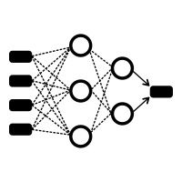
Physically Consistent NNs (PCNNs)
Enforce physical properties by design in a module running in parallel of the NN
Building thermodynamics example
We want to ensure:
The predicted temperatures increase when the applied heating power or the outside temperature increases;
Physically meaningful energy flows between the thermal zones.
This is hard-encoded in the physics-inspired module, which processes the power inputs, ambient temperatures, and energy exchanges between the zones.
The parameters are learned from data
*
*

Slide 37
Solving the shortcut learning issue
Case study on UMAR: learn the thermodynamics of buildings
PiNNs and LSTMs have a great accuracy on the validation data – PCNNs are physically consistent by construction
Notes:
If want something that works in heating and cooling either wait 6 months or use a model

Slide 38
Solving the shortcut learning issue
Case study on UMAR: learn the thermodynamics of buildings
PiNNs and LSTMs have a great accuracy on the validation data – PCNNs are physically consistent by construction
But they also outperform all the other physically consistent methods by 17-35%
Notes:
If want something that works in heating and cooling either wait 6 months or use a model

Slide 39
Simulation
DRL agents converge to behaviors similar to the optimal trajectories (computed a posteriori)
Confirmed by statistical analysis over 2000 3-day long sequences
And for different reward functions and random seeds

Slide 40
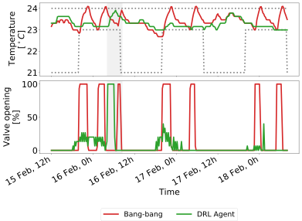
Experiment
Connection
lost
Only short period because of connection issues
But the agent shows similar behavior as in simulation
Preheating
Close to lower bound

Slide 41
An issue of convergence speed
Introduction
100k steps
Roughly 3 years worh of data
3 years worth of data (randomly sampled days) to obtain the performance of classical rule-based controllers
15 years (500k points) to “converge”
(D)RL is usually (very, very, very) data-inefficient
High computational burden
Limited deployment on physical systems
Notes:
If want something that works in heating and cooling either wait 6 months or use a model

Slide 42
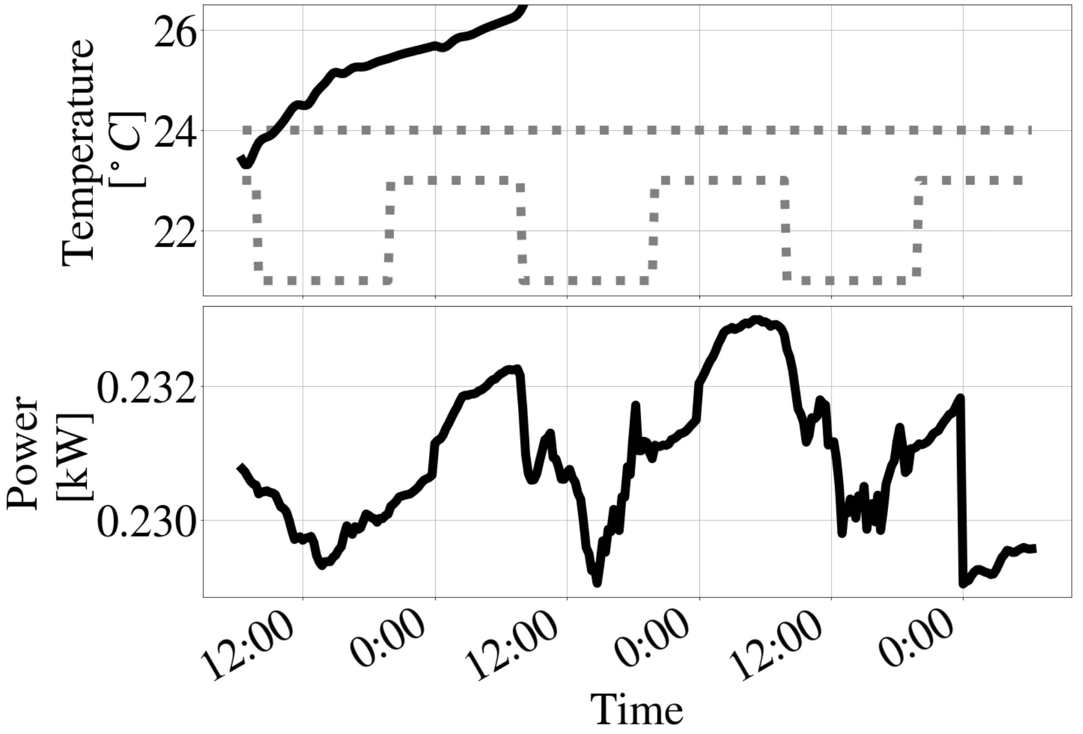
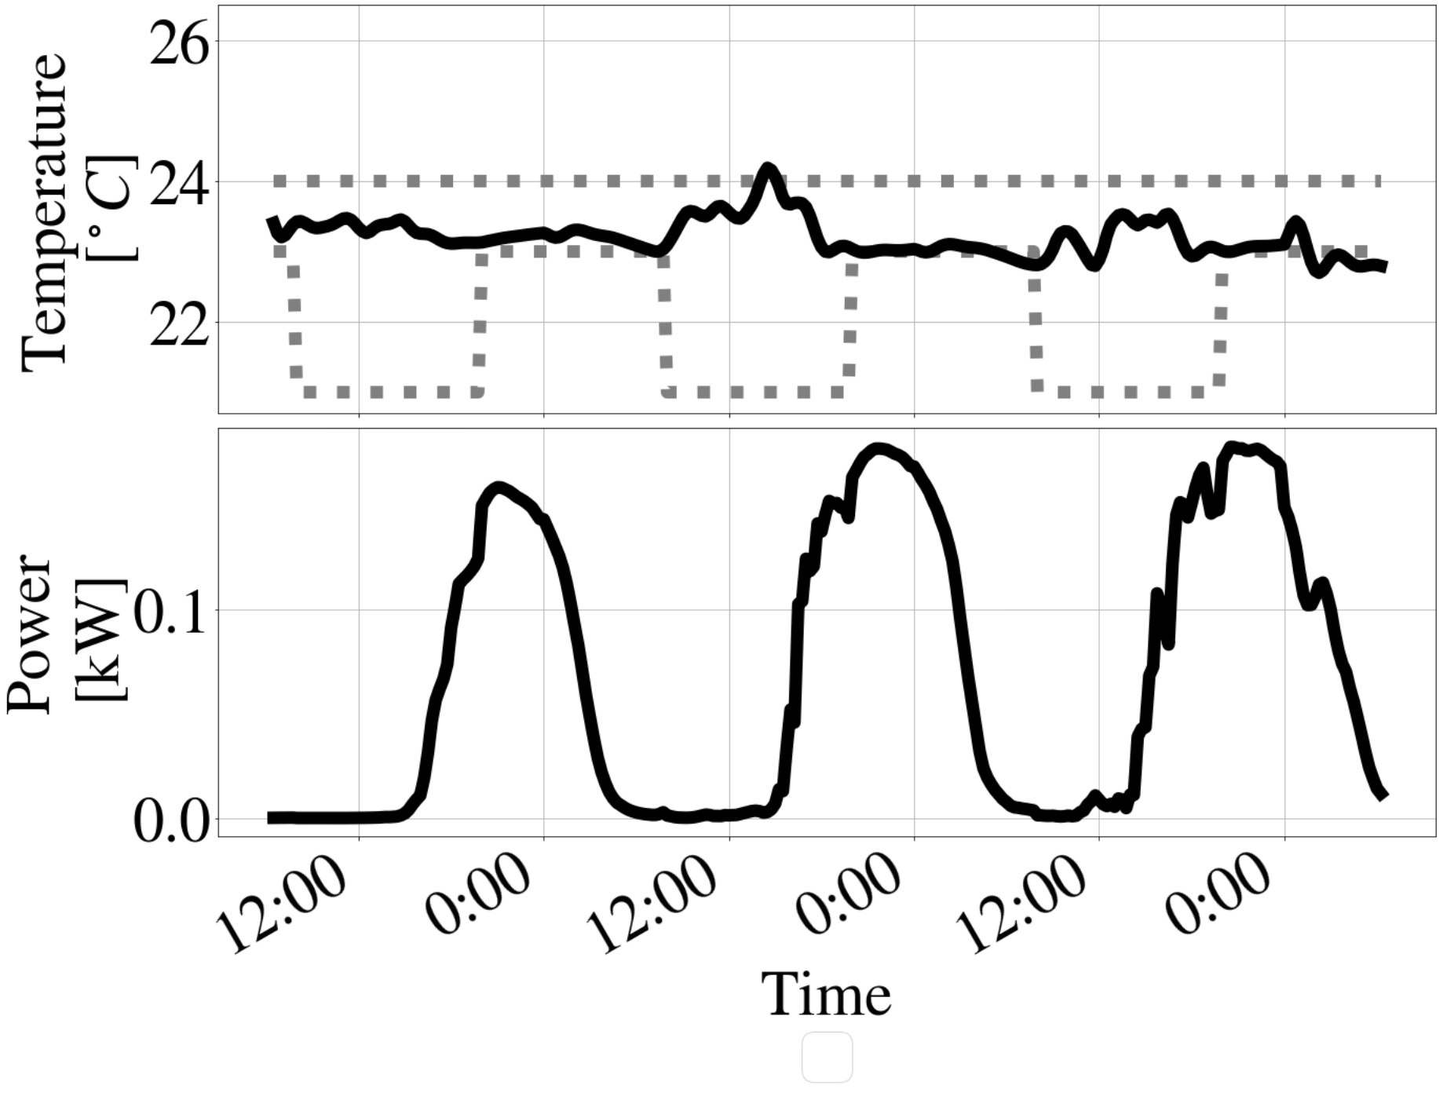
Why?
Introduction
To get there…
… we need this!
Exploration is necessary
… but often stupid!
Postulate
Prior expert knowledge often provides intuition about what optimal policies should do
We can accordingly constrain the agents to regions of the state space that are deemed interesting
Notes:
If want something that works in heating and cooling either wait 6 months or use a model

Slide 43
Proposed approach to accelerate learning
Methods
Proposed approach
How can we constrain the actions of agents to explore interesting states?
Design handcrafted simple rules from expert knowledge to ensure meaningful actions
Saturate the agents’ actions according to these rules
Modify the gradient update of the policy to let it learn from the corrections and steer it towards expected behaviors
Agent
x
x
A
Notes:
If want something that works in heating and cooling either wait 6 months or use a model

Slide 44
Proposed approach to accelerate learning
Methods
How can we constrain the actions of agents to explore interesting states?
Correct the agents using safe action sets
- but no need to always satisfy these artifical constraints!
Design handcrafted simple rules from expert knowledge to ensure meaningful actions
Saturate the agents’ actions according to these rules
Modify the gradient update of the policy to let it learn from the corrections and steer it towards expected behaviors
Each step is easy to implement and computationally inexpensive
Notes:
If want something that works in heating and cooling either wait 6 months or use a model

Slide 45
What does the saturation do?
Introduction
To get there…
… we need this!
Meaningful exploration
Notes:
If want something that works in heating and cooling either wait 6 months or use a model

Slide 46
Does it impact performance?
Results
The learnt behaviors are similar!
Good final performance

Slide 47
Does it accelerate learning?
Results
Reward Shaping (RS)
Efficient Agents (EAs) (ours)
Classical Agents
Smaller n
tighter constraints
Impact of m on EAs (ours) – more freedom
Main metric: number of days of data required to converged to the performance of industrial baselines

Slide 48
Does it accelerate learning?
Results

Slide 49
Does it accelerate learning?
Results
Objective attained! Up to 6-7x faster

Slide 50
Discussion & Conclusion
Wrap-up
Black-box models can be misleading, even if they fit the data well
PCNNs as a potential solution - easy to scale
Deep Reinforcement Learning provides good results when coupled with PCNNs
It is possible to design simple rules based on prior knowledge to help (D)RL agents converge faster
Saturate the actions of the agents accordingly
Modify the gradient update to let agents learn from it
→ Fully black-box pipeline from data to control policies
→ Avoid tedious engineering
→ Energy savings of 25-30%
→ Comfort of the occupants improved
Straightforward implementation
Computationally inexpensive
→ Up to 6-7 times faster
→ “Plug & Play” controllers

Slide 51
Discussion & Conclusion
Wrap-up
Neural Networks can be misleading, even if they fit the data well
PCNNs as a potential solution - easy to scale
Deep Reinforcement Learning provides good results when coupled with PCNNs
It is possible to design simple rules based on prior knowledge to help (D)RL agents converge faster
Saturate the actions of the agents accordingly
Modify the gradient update to let agents learn from it
→ Fully black-box pipeline from data to control policies
State-of-the-art accuracy
Physical consistency
→ Energy savings of 25-30%
→ Comfort of the occupants improved
Straightforward implementation
Computationally inexpensive
→ Up to 6-7 times faster
→ “Plug & Play” controllers

Slide 52
Main references
PCNNs
Towards Scalable Physically Consistent Neural Networks: an Application to Data-driven Multi-zone Thermal Building Models. L. Di Natale, B. Svetozarevic, P. Heer, and C.N. Jones (2022). Manuscript submitted to Applied Energy. https://arxiv.org/abs/2212.12380.
Physically consistent neural network building models: theory and analysis. L. Di Natale, B. Svetozarevic, P. Heer, and C.N. Jones (2022). Applied Energy, 119806. https://doi.org/10.1016/j.apenergy.2022.119806.
DRL
Efficient Reinforcement Learning (ERL): Targeted Exploration Through Action Saturation. L. Di Natale, B. Svetozarevic, P. Heer, and C.N. Jones (2022). Manuscript submitted to L4DC 2023. https://arxiv.org/abs/2211.16691.
Near-optimal Deep Reinforcement Learning Policies from Data for Zone Temperature Control. L. Di Natale, B. Svetozarevic, P. Heer, and C.N. Jones (2022). 2022 IEEE 17th International Conference on Control & Automation (ICCA), 698-703. https://doi.org/10.1109/ICCA54724.2022.9831914.

